Slide 1


Customer Retention
Prepared By:
SHRUTI GAMNE

Slide 2
INTRODUCTION
In today’s corporate and competitive world. I find that Online shopping has the maximum growth potential as compared to the other sectors. It has the maximum growth rate. The growth potential attracts individuals to enter this sector and Flip Robo Technologies Company has given me the opportunity to get a peek of highly competitive and enhancing sector. The major factors affecting the purchase of an online product are trust, service, product features and relationship with Customers. Websites like Amazon.com, Flipkart.com are favoured only because of being most efficient websites for online shopping as per the data. People are now getting aware of the various online shopping websites, apps etc available in the market.

Slide 3
Problem Statement
Here we have studied the data of respondents and their views and other details regarding online Shopping. So the Customer Retention is one of the major problem many companies face. So we are going to do analysis on the previous data and try to give the customer maximum satisfaction by providing good service so that customer always purchase from the online store.

Slide 4
Dataset Customer Retention dataset(269 Rows,71 Columns)
 | 1Gender of respondent | 2 How old are you? | 3 Which city do you shop online from? | 4 What is the Pin Code of where you shop online from? | 5 Since How Long You are Shopping Online ? | 6 How many times you have made an online purchase in the past 1 year? | 7 How do you access the internet while shopping on-line? | 8 Which device do you use to access the online shopping? | 9 What is the screen size of your mobile device?\t\t\t\t\t\t | 10 What is the operating system (OS) of your device?\t\t\t\t | ... | Longer time to get logged in (promotion, sales period) | Longer time in displaying graphics and photos (promotion, sales period)
0 | Male | 31-40 years | Delhi | 110009 | Above 4 years | 31-40 times | Dial-up | Desktop | Others | Window/windows Mobile | ... | Amazon.in | Amazon.in
1 | Female | 21-30 years | Delhi | 110030 | Above 4 years | 41 times and above | Wi-Fi | Smartphone | 4.7 inches | IOS/Mac | ... | Amazon.in, Flipkart.com | Myntra.com
2 | Female | 21-30 years | Greater Noida | 201308 | 3-4 years | 41 times and above | Mobile Internet | Smartphone | 5.5 inches | Android | ... | Myntra.com | Myntra.com
3 | Male | 21-30 years | Karnal | 132001 | 3-4 years | Less than 10 times | Mobile Internet | Smartphone | 5.5 inches | IOS/Mac | ... | Snapdeal.com | Myntra.com, Snapdeal.com
4 | Female | 21-30 years | Bangalore | 530068 | 2-3 years | 11-20 times | Wi-Fi | Smartphone | 4.7 inches | IOS/Mac | ... | Flipkart.com, Paytm.com | Paytm.com
... | ... | ... | ... | ... | ... | ... | ... | ... | ... | ... | ... | ... | ...
264 | Female | 21-30 years | Solan | 173212 | 1-2 years | Less than 10 times | Mobile Internet | Smartphone | 5.5 inches | Android | ... | Amazon.in | Amazon.in

Slide 5
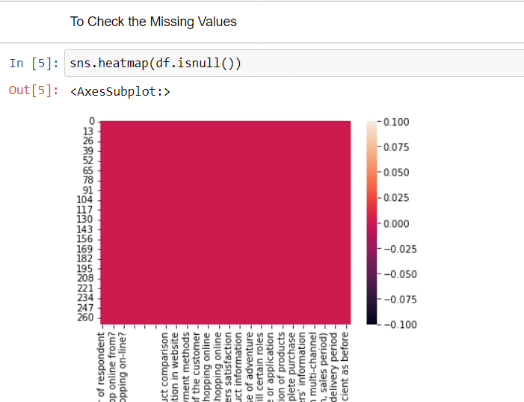
Checking for missing value There are Missing values present

Slide 6
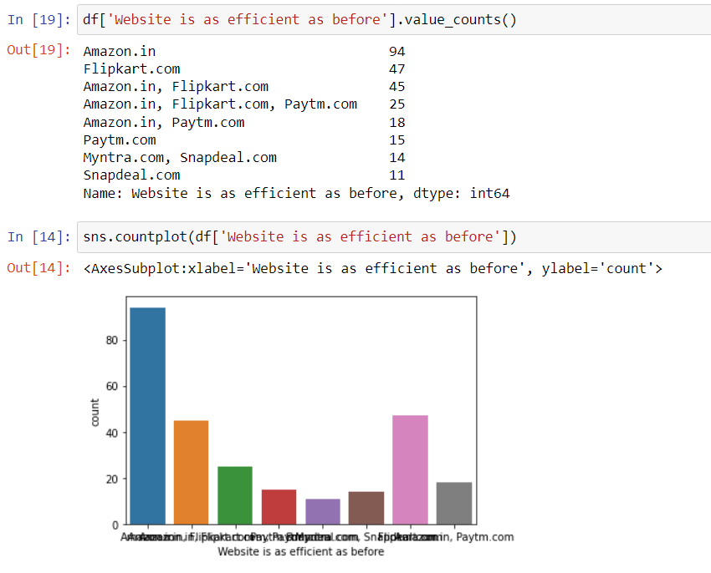
Top Websites Amazon.in and Flipkart.com are one of the top websites for online shopping

Slide 7
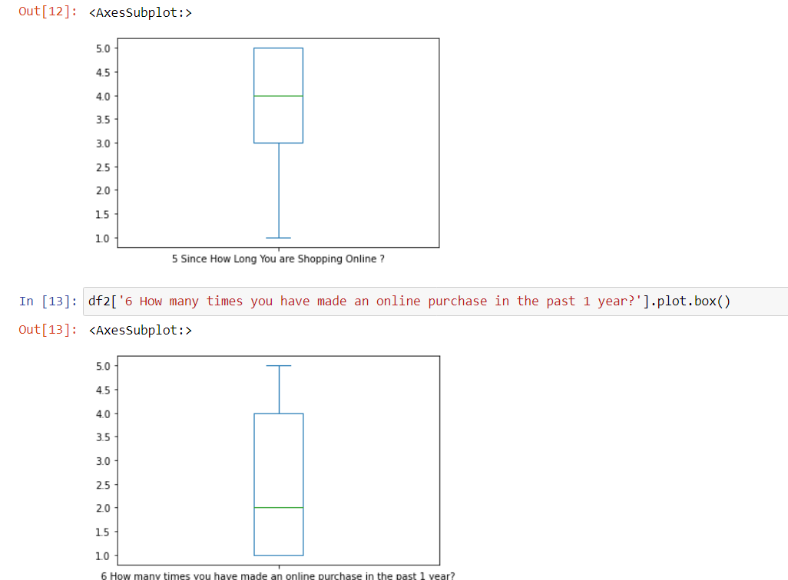
Univariate Analysis Boxplot

Slide 8
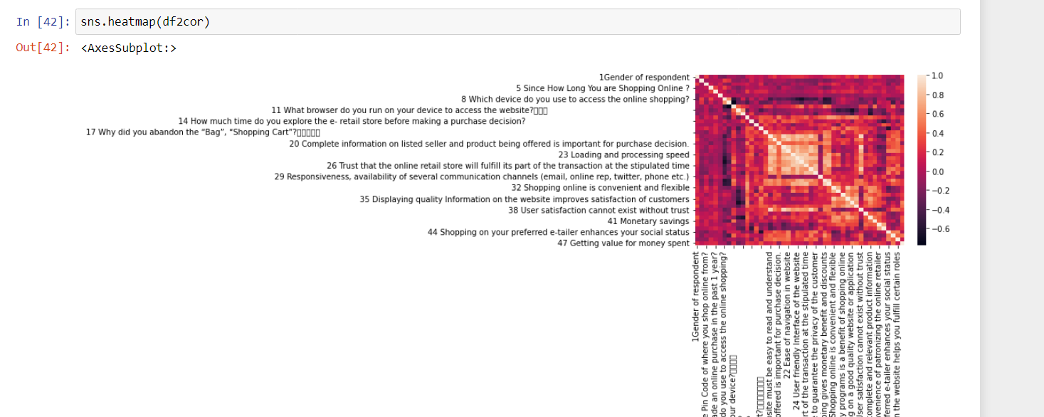
Correlation plot

Slide 9
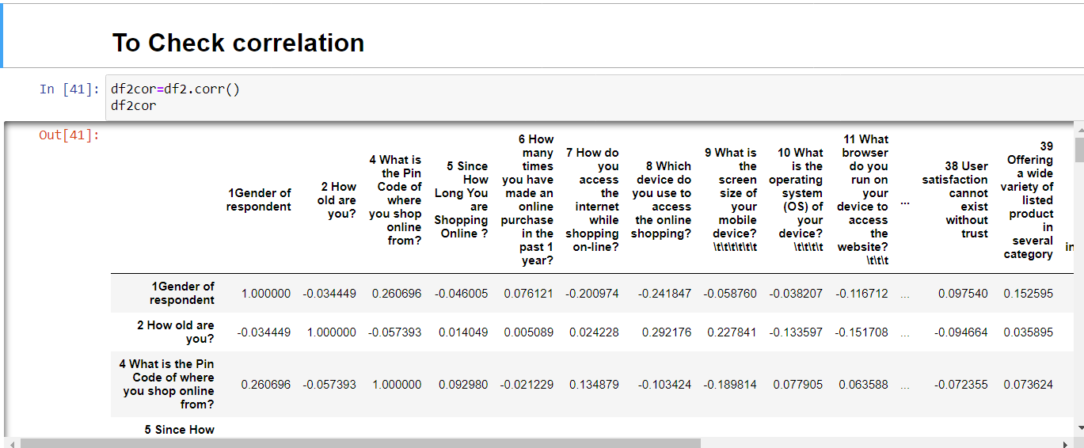
Values of correlation

Slide 10
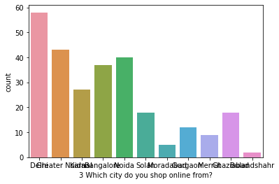
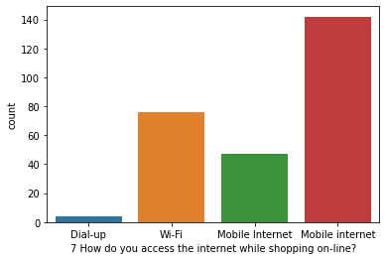
Count plot

Slide 11
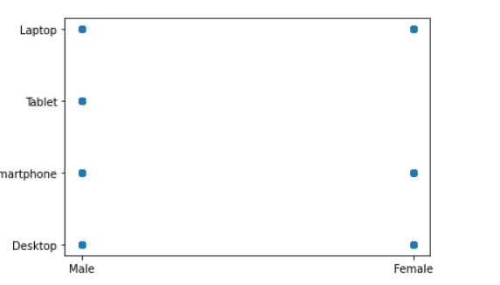
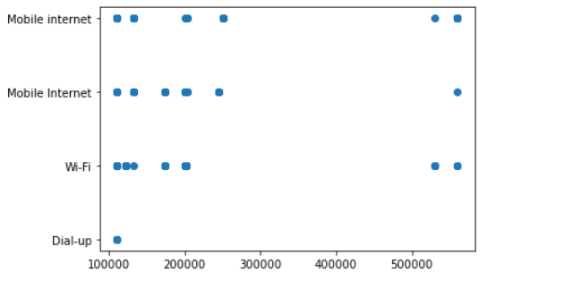
Bivariate Analysis scatter plot

Slide 12
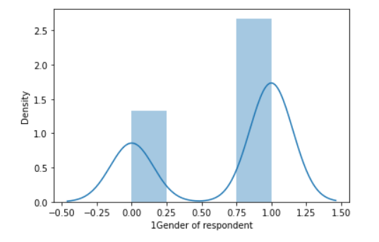
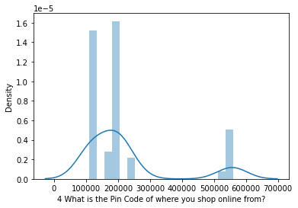
To check distribution of skewness

Slide 13
Conclusion
34.94% of the customers prefer Amazon.in, 17.47% prefer to use Flipkart.com.
Customers Strongly agree that content on the website is easy to read, All relevant information is Listed, Navigation is easy, has user friendly Interface of the website, has Convenient Payment methods, Online shopping gives monetary benefit and discounts
Many of them like Amazon.in, because of its services like speedy delivery, Availability of several payment options, Security of customer financial information Complete, relevant description information of products and Wild variety of product on offer
The study reveals that 36.43% of respondents are Shopping Online for above 4 years
The study reveals that 52.78% of respondents access the internet while shopping on-line instead of WIFI and dial-up.
It is found that majority of 21.56% people are from Delhi who purchase online products.
They want to know more about their products as they doesn’t have brief knowledge about the products and the benefits given by them.

